Slide 1
Why Cryptosystems Fail
Ross Anderson, Cambridge University
Presented by: Ryan Riley

Slide 2
Introduction
Cryptology is widely used to keep information secure
The largest implementations of it are secret
Government/military
Cryptographers get no feedback about failures

Slide 3

Example: Airlines
Airplane crashes are investigated in depth
Investigators go to the scene
Lots of invested parties are involved
Findings are examined by others
Engineers can modify their designs based on what is learned
Institutionalized learning mechanism

Slide 4
Crypto Community
No such learning mechanism
Modern cryptographic systems are widely deployed in governments, but failures are not shared
We are at a disadvantage!

Slide 5
Crypto’s Traditional Threat Model
System implementation and operation is basically error-free
Those designing and maintaining the systems are competent
Attacker is highly skilled and focused on cryptanalysis
NSA/GCHQ level

Slide 6
Today’s Talk
Examples from banking
Traditional threat model is very wrong
What new threat model should
Recommendations for the future (paradigm shift)

Slide 7
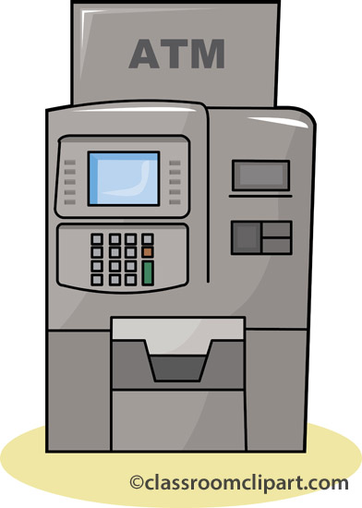
ATM Fraud
Another application of crypto is ATM machines at banks
Involved in consulting on court cases related to this
Very powerful lessons to be learned here
Our airline crash investigation team

Slide 8
Basic ATM Fraud
Basic ATM fraud can occur in a variety of ways
None of these are very technical

Slide 9

Basic: Bank Staff
Bank clerk in Hastings, England issued a extra ATM card for a customer’s account
Stole 8600 GBP
Customer complaint was ignored
Maintenance engineering in Scotland modified an ATM to record PIN & account numbers
Customer complaints were ignored

Slide 10

Basic: Outsiders
Postal interception
Fake ATMs
Issuing the same PIN to everyone
Hard to detect!

Slide 11
Basic: Implementation Issues
Two men in England watched people enter their PINs, then got account numbers from receipts
Same technique was used years prior in New York
Banks kept printing account #s for years
ATM Jackpotting

Slide 12
Basic: Implementation Issues
Encrypted PIN is stored on the card, but not tied to the account #
Intentionally limiting the possible PINs
Offline ATMs: Copied cards be used simultaneously

Slide 13
Complex ATM Fraud
More complex types of fraud occur as well
Mostly related to poor key management

Slide 14
ATM Encryption Primer
Account number: | 8807012345691710
PIN key: | FEFEFEFEFEFEFEFE
Result of DES: | A2CE126C69AEC82D
Result decimalised: | 0224126269042823
Natural PIN: | 0224
Offset: | 6565
Customer PIN: | 6789

Slide 15
ATM Encryption Primer
ATM must have PIN key to verify PIN
Each bank uses a unique PIN key
Distributing these keys to ATMs and between different banks involves more keys
Terminal keys
Working keys
Zone keys
Take-away: Banks have lots of keys to keep secret

Slide 16
Complex Fraud: Software Problems
Encryption is frequently done in bank software
Developers can get keys
No one even verifies that correct keys are used

Slide 17
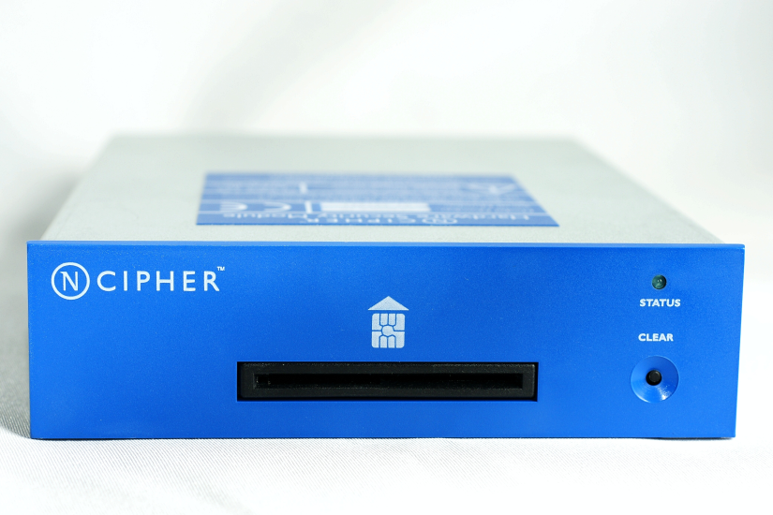
Complex Fraud: Hardware
Solution to this is a Security Module
PC in a safe
Programmers use it, but never see keys

Slide 18
Complex Fraud: Hardware Problems
Many banks don’t use SMs
SMs might not interoperate well with other systems
Malicious contractor
Poorly designed SMs
Easily opened and tampered with

Slide 19
Complex Fraud: Implementation Issues
SM error codes not being checked
PIN keys being given to contractors
Can you trust them?
Key management is poor
Give it all to the technical guy!
Managers delegating key management duties
Employees don’t understand crypto security like physical security

Slide 20
Implications for Banks
Competent consultants are needed
Acknowledge mistakes will happen
Burden of proof should be on party who can investigate

Slide 21
Implications for SM Vendors
Don’t over-estimate client knowledge of crypto
Products should be produced by experts
And assumed to be used by non-experts
Certification process must include the human component
Human environment where it will be used

Slide 22
Important Lessons
Recall our threat model…
System implementation and operation is basically error-free
Those designing and maintaining the systems are competent
Our threat model was wrong!
Implementations error filled
Designers and maintainers incompetent

Slide 23

Incompetent?
Security is hard
Most organizations don’t have a dedicated team
Staff are afraid to report issues
Corporate politics are bad
Non-experts don’t know when a consultant is incompetent

Slide 24
New Paradigm
Don’t focus on what could go wrong, but what is likely to
Security should be an “engineering discipline concerned with quality control processes within the client organisation”

Slide 25
Four Points on System Design
Specification should list failure modes
… and strategies to address them
… and how they are implemented (including training and operational issues)
Certification must test system usage by people with appropriate skill levels

Slide 26
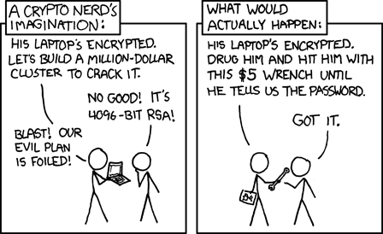
Conclusions
Our threat model is wrong
We assumed technical attacks on the crypto
Most failures are…
Bad implementation
Human factor

